Slide 1

Loaders in Android
Vitaliy Ishchuk
06.11.2013

Slide 2


Agenda
0. Intro
Hello Loaders;
Life before Loaders;
Let`s go Loaders;
Short Demo;
Conclusions;
Questions.

Slide 3



Threads in Android
By default application works in UI thread.
If app no response to an input event (such as key press or screen touch events) within 5 seconds you will see "Application Not Responding" (ANR) dialog.
To avoid ANR dialogs is use Multithreading
Thread
AsyncTask

Slide 4
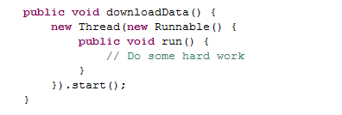
Thread
java.lang.Object
↳
java.lang.Thread

Slide 5
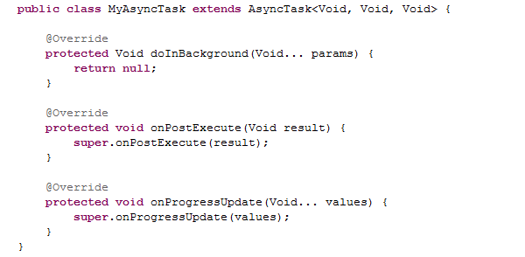
AsyncTask
java.lang.Object
↳ | android.os.AsyncTask<Params, Progress, Result>

Slide 6

Hello Loaders
Introduced in Android 3.0, loaders make it easy to asynchronously load data in an activity or fragment. Loaders have these characteristics:
They are available to every Activity and Fragment.
They provide asynchronous loading of data.
They monitor the source of their data and deliver new results when the content changes.
They automatically reconnect to the last loader's cursor when being recreated after a configuration change. Thus, they don't need to re-query their data.

Slide 7
Life before Loaders
Methods:
public void startManagingCursor(Cursor);
public void stopManagingCursor(Cursor);
public Cursor managedQuery(Uri, String, String, String, String);
requery ();
- All are depricated;
- Work in UI thread;
- Doesn`t retaining Cursor state across configuration changes;
- Ineffective;

Slide 8
Loader API Summary
LoaderManager | Manages your Loaders for you. Responsible for dealing with the Activity or Fragment lifecycle
LoaderManager.LoaderCallbacks | A callback interface for a client to interact with the LoaderManager.
Loader | An abstract class that performs asynchronous loading of data. This is the base class for a loader.
AsyncTaskLoader | Abstract loader that provides an AsyncTask to do the work.
CursorLoader | A subclass of AsyncTaskLoader that queries the ContentResolver and returns a Cursor.

Slide 9
What is the LoaderManager
LoaderManager:
doesn`t know how data is loaded;
instructs its Loaders when to start/stop/reset their data;
retaining their state across configuration changes;
provide simple interface for delivering results back to the client.
Differences between startManagingCursor(Cursor):
startManagingCursor manages Cursor, whereas the LoaderManager manages Loader<D> objects;
startManagingCursor does not retain the Cursor`s state across configuration changes;
The LoaderManager provides seamless monitoring of data;

Slide 10
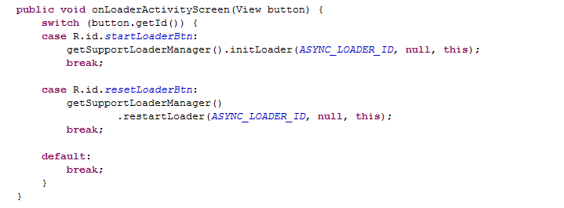
Implementing the LoaderManager
getLoaderManager () - Return the LoaderManager for this fragment or activity, creating it if needed;

Slide 11
Implementing the LoaderManager
public abstract Loader<D> initLoader (int id, Bundle args, LoaderCallbacks<D> callback) - Ensures a loader is initialized and active. Params:
id - A unique identifier for this loader.
args - Optional arguments to supply to the loader at construction.
callback - Interface the LoaderManager will call to report about changes in the state of the loader.
public abstract Loader<D> restartLoader (int id, Bundle args, LoaderCallbacks<D> callback) - Starts a new or restarts an existing Loader in this manager, registers the callbacks to it, and (if the activity/fragment is currently started) starts loading it. If a loader with the same id has previously been started it will automatically be destroyed when the new loader completes its work.
public abstract void destroyLoader (int id) - Stops and removes the loader with the given ID. If this loader had previously reported data to the client through onLoadFinished(Loader, Object), a call will be made to onLoaderReset(Loader).

Slide 12
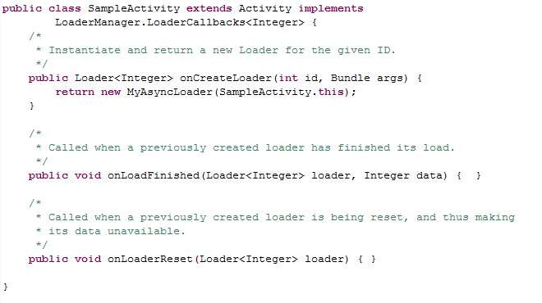
LoaderManager.LoaderCallback

Slide 13
Implementing Loaders
Loader - An abstract class that performs asynchronous loading of data.
AsyncTaskLoader - Abstract Loader that provides an AsyncTask to do the work.
CursorLoader - A loader that queries the ContentResolver and returns a Cursor.
Subclasses must implement:
onStartLoading();
onStopLoading();
onReset();
onCanceled(D data);
loadInBackground();
deliverResult(D data).

Slide 14
Loader lifecycle
Code from Activity/Fragment:
onStartLoading();
onForceLoad();
onLoadInBackground();
deliverResult();
First call:
getSupportLoaderManager().initLoader(ID, null, this);
onCreateLoader();
onLoadFinished();
onAbandon();
onStartLoading();
onForceLoad();
onLoadInBackground();
deliverResult();
onReset();
getSupportLoaderManager().restartLoader(ID, null, this);
onCreateLoader();
onLoadFinished();

Slide 15
Demo

Slide 16
Conclusions
android:configChanges
onSaveInstanceState()
onRetainNonConfigurationInstance()
- Depricated
+ Don`t need to create own listeners;
+ Easily save data across configuration changed;
+ Friendly interface for managing data;
- Sometimes a lot of code, classes;
- Destroy with Activity/Fragment;
- Using only in Activity or Fragment;

Slide 17

What should we use ?
AsyncTask
AsyncTaskLoader

Slide 18

Questions

Slide 19


http://developer.android.com/guide/components/loaders.html
https://github.com/supervital/loadertutorial
http://www.androiddesignpatterns.com/2012/07/loaders-and-loadermanager-background.html
http://www.grokkingandroid.com/using-loaders-in-android/

